Slide 1


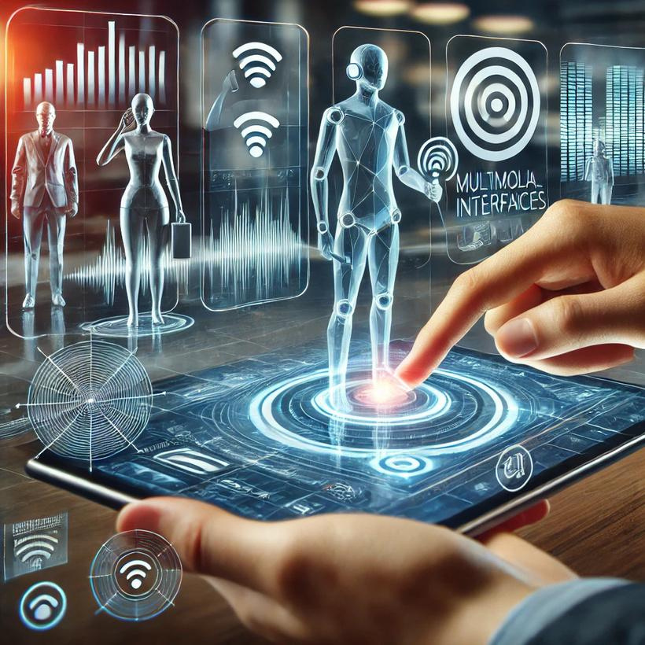

Multimodal Interfaces
2024

Slide 2





Summary
01
Summary
07
Practical Applications
02
Multimodal Interface ?
08
Countries leading investment in multimodal interface technologies
03
09
Message to us
Foundations of Multimodal Interfaces
04
10
Our sources
Advantages of Multimodal Interfaces
05
Importance and Relevance of Multimodal Interfaces
11
Conclusion
06
Challenges and Limitations of Multimodal Interfaces
12
The End

Slide 3




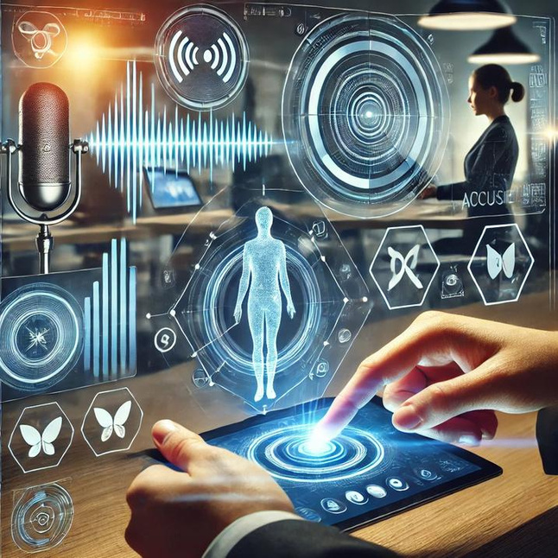
Multimodal Interface ?
Multimodal Interface ?
A multimodal interface is a type of human-computer interaction system that allows users to communicate with a device or software through multiple modes or channels of interaction simultaneously or interchangeably.

Slide 4
Foundations of Multimodal Interfaces
Interaction Modes
Visual: Screens, graphical user interfaces, augmented reality.
Auditory: Voice recognition, sound feedback.
Haptic: Touchscreens, vibrations.
Gestural: Motion detection via cameras (e.g., Kinect, Leap Motion).

Slide 5
Foundations of Multimodal Interfaces
Technologies Used
Sensors (cameras, microphones, haptic sensors).
AI algorithms to process and interpret multimodal data.
Multimodal Design
Combining data from different channels to create a seamless user experience.

Slide 6

Advantages of Multimodal Interfaces
Improved User Experience (UX)
Increased Accessibility
Versatility and Robustness
01
02
03
Multimodal interfaces mimic human communication by allowing users to interact with systems in ways they find natural, such as speaking, gesturing, or touching. For example, using voice commands to control a smart device while simultaneously gesturing enhances usability.
Multimodal interfaces cater to users with disabilities. For instance, visually impaired users can rely on voice or tactile feedback, while hearing-impaired users benefit from visual and gestural inputs. This inclusivity ensures broader access to technology.
Multimodal systems are flexible and can combine multiple modes for more efficient interaction. For instance, a user might speak a command and then refine it using a touch interface.

Slide 7

Challenges and Limitations of Multimodal Interfaces
(Technical Complexity)
Integration and
Synchronization
Real-time Data Processing
01
02
Multimodal systems require seamless integration of various input and output modes (e.g., voice, gestures, touch). Ensuring that these modes work together without lag or miscommunication is technically challenging. For example, combining voice commands with gesture recognition demands precise synchronization to avoid user frustration.
Processing multimodal inputs in real-time is computationally intensive. Systems must analyze and respond to voice, gestures, and other inputs simultaneously without delay. This requires advanced hardware and efficient algorithms, which can strain system performance and increase costs.

Slide 8

Challenges and Limitations of Multimodal Interfaces
(Development Costs)
Advanced Sensors
Powerful Learning Algorithms
01
02
Multimodal interfaces depend on specialized hardware like high-quality microphones, cameras, and haptic sensors to accurately capture inputs. Developing and integrating these components can significantly increase production costs.
Machine learning models used for voice recognition, gesture detection, and context interpretation require extensive training and computational resources, adding to the overall development expense.

Slide 9
Challenges and Limitations of Multimodal Interfaces
(Ethics and Privacy Concerns)
Capturing Sensitive Data
Data Security Risks
01
02
Multimodal systems often rely on sensitive user data, such as voice recordings, facial expressions, or body movements. This raises concerns about how data is collected, stored, and used. For example, users might feel uneasy about systems that continuously record their voices or gestures for analysis.
Storing and processing multimodal data increases the risk of breaches and unauthorized access. Hackers could exploit voice or facial data for identity theft, making robust encryption and privacy policies essential but costly to implement.

Slide 10

Practical Applications
Voice control for managing home devices

Slide 11
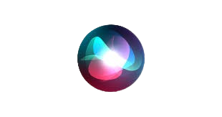
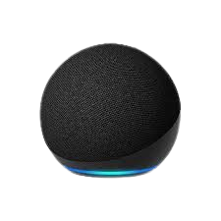
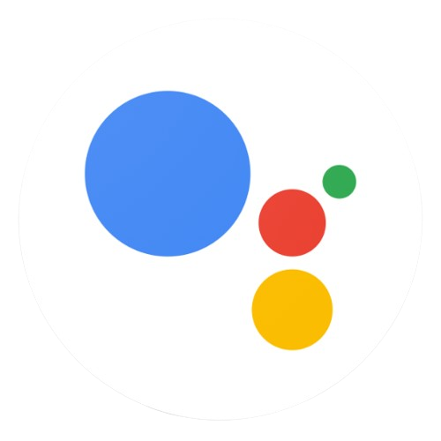
Practical Applications
Examples
Google Assistant
Siri
Alexa

Slide 12

Practical Applications
Interfaces in vehicles (voice, touch, gestures for GPS or radio)

Slide 13

Practical Applications
Interfaces for disabled patients (controlled by voice or motion)

Slide 14
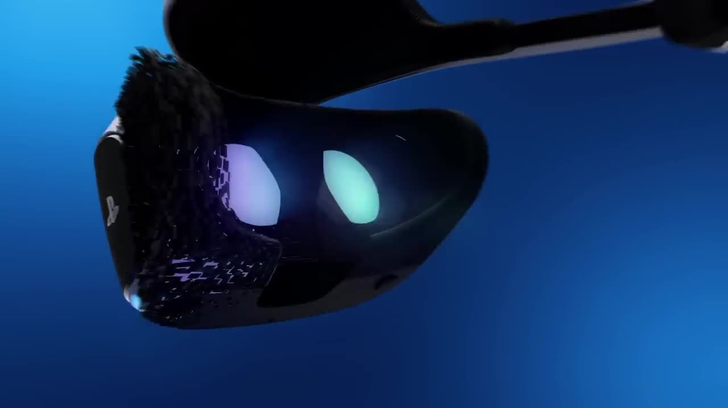
Practical Applications
PlayStation VR

Slide 15
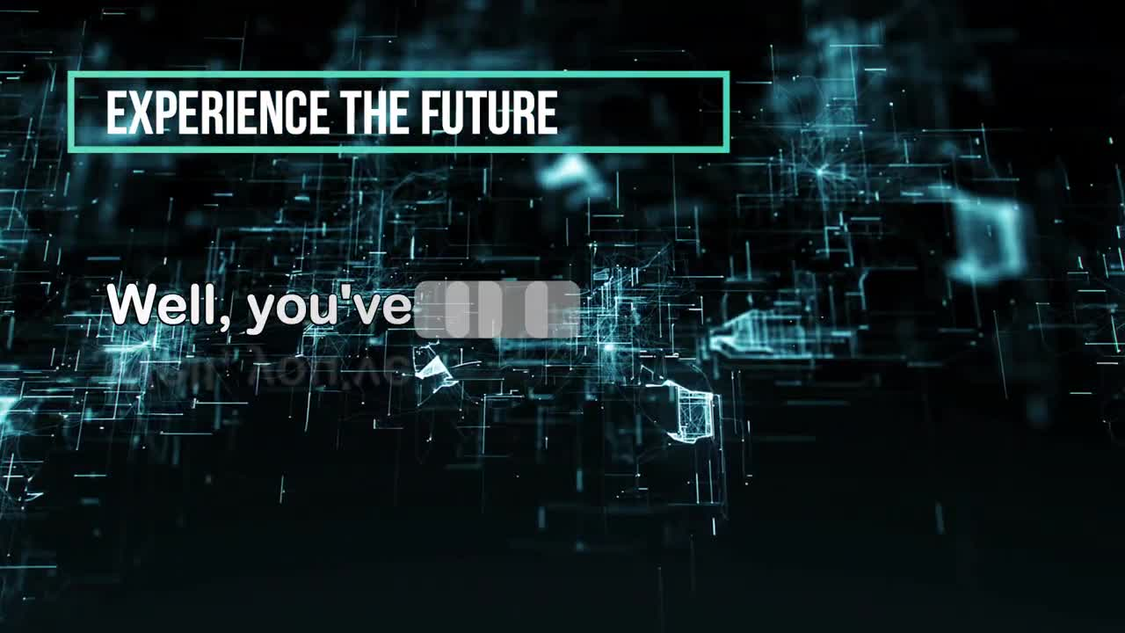
Practical Applications
Pepper Robot : The future of Human_ROBOT Interaction

Slide 16




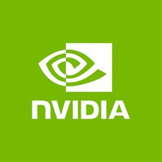





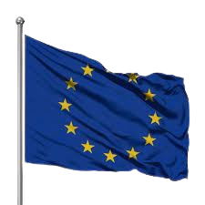


Countries leading investment in multimodal interface technologies

Slide 17
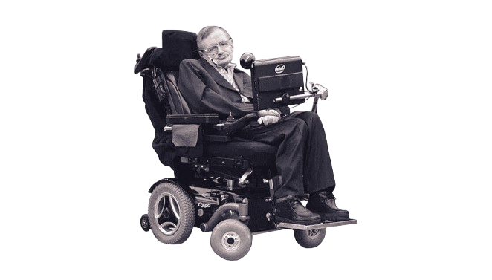
Message to us
"The greatest enemy of knowledge is not ignorance, it is the illusion of knowledge." Stephen Hawking
1942-2018

Slide 18



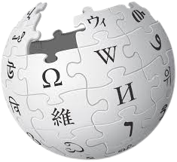
Our sources
We strive to offer the best, and that's why we rely on the best sources worldwide.

Slide 19
Conclusion
The adoption of multimodal interfaces is key to advancing nations, improving accessibility, and boosting innovation in critical sectors like education and healthcare. Developed countries have leveraged these technologies to enhance productivity and set global standards. Developing nations can follow their example by focusing on education, empowering youth with technical skills, and fostering innovation. Investing in young talent is essential to drive progress, bridge technological gaps, and achieve sustainable development for the future.

Slide 20





"Thank you for watching our presentation."
2024

